Slide 1
EARTH: 20000
Pimped out version of Arkanoid
Group Members:
Ivan Collazo
Manpreet Kohli
Natraj Subramanian

Slide 2
Progress so far
Story-board
Finite State Machine for the game
Gantt Chart
Splash Screen
Some classes planned out
Block class created

Slide 3
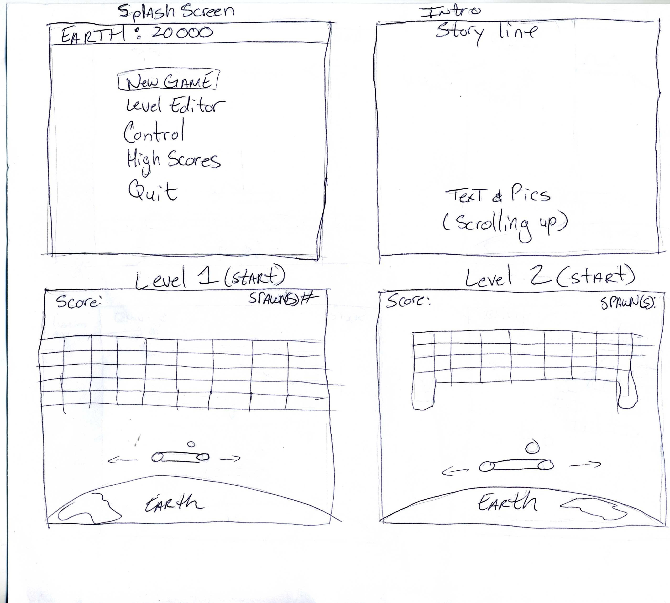
Story Board (1)

Slide 4
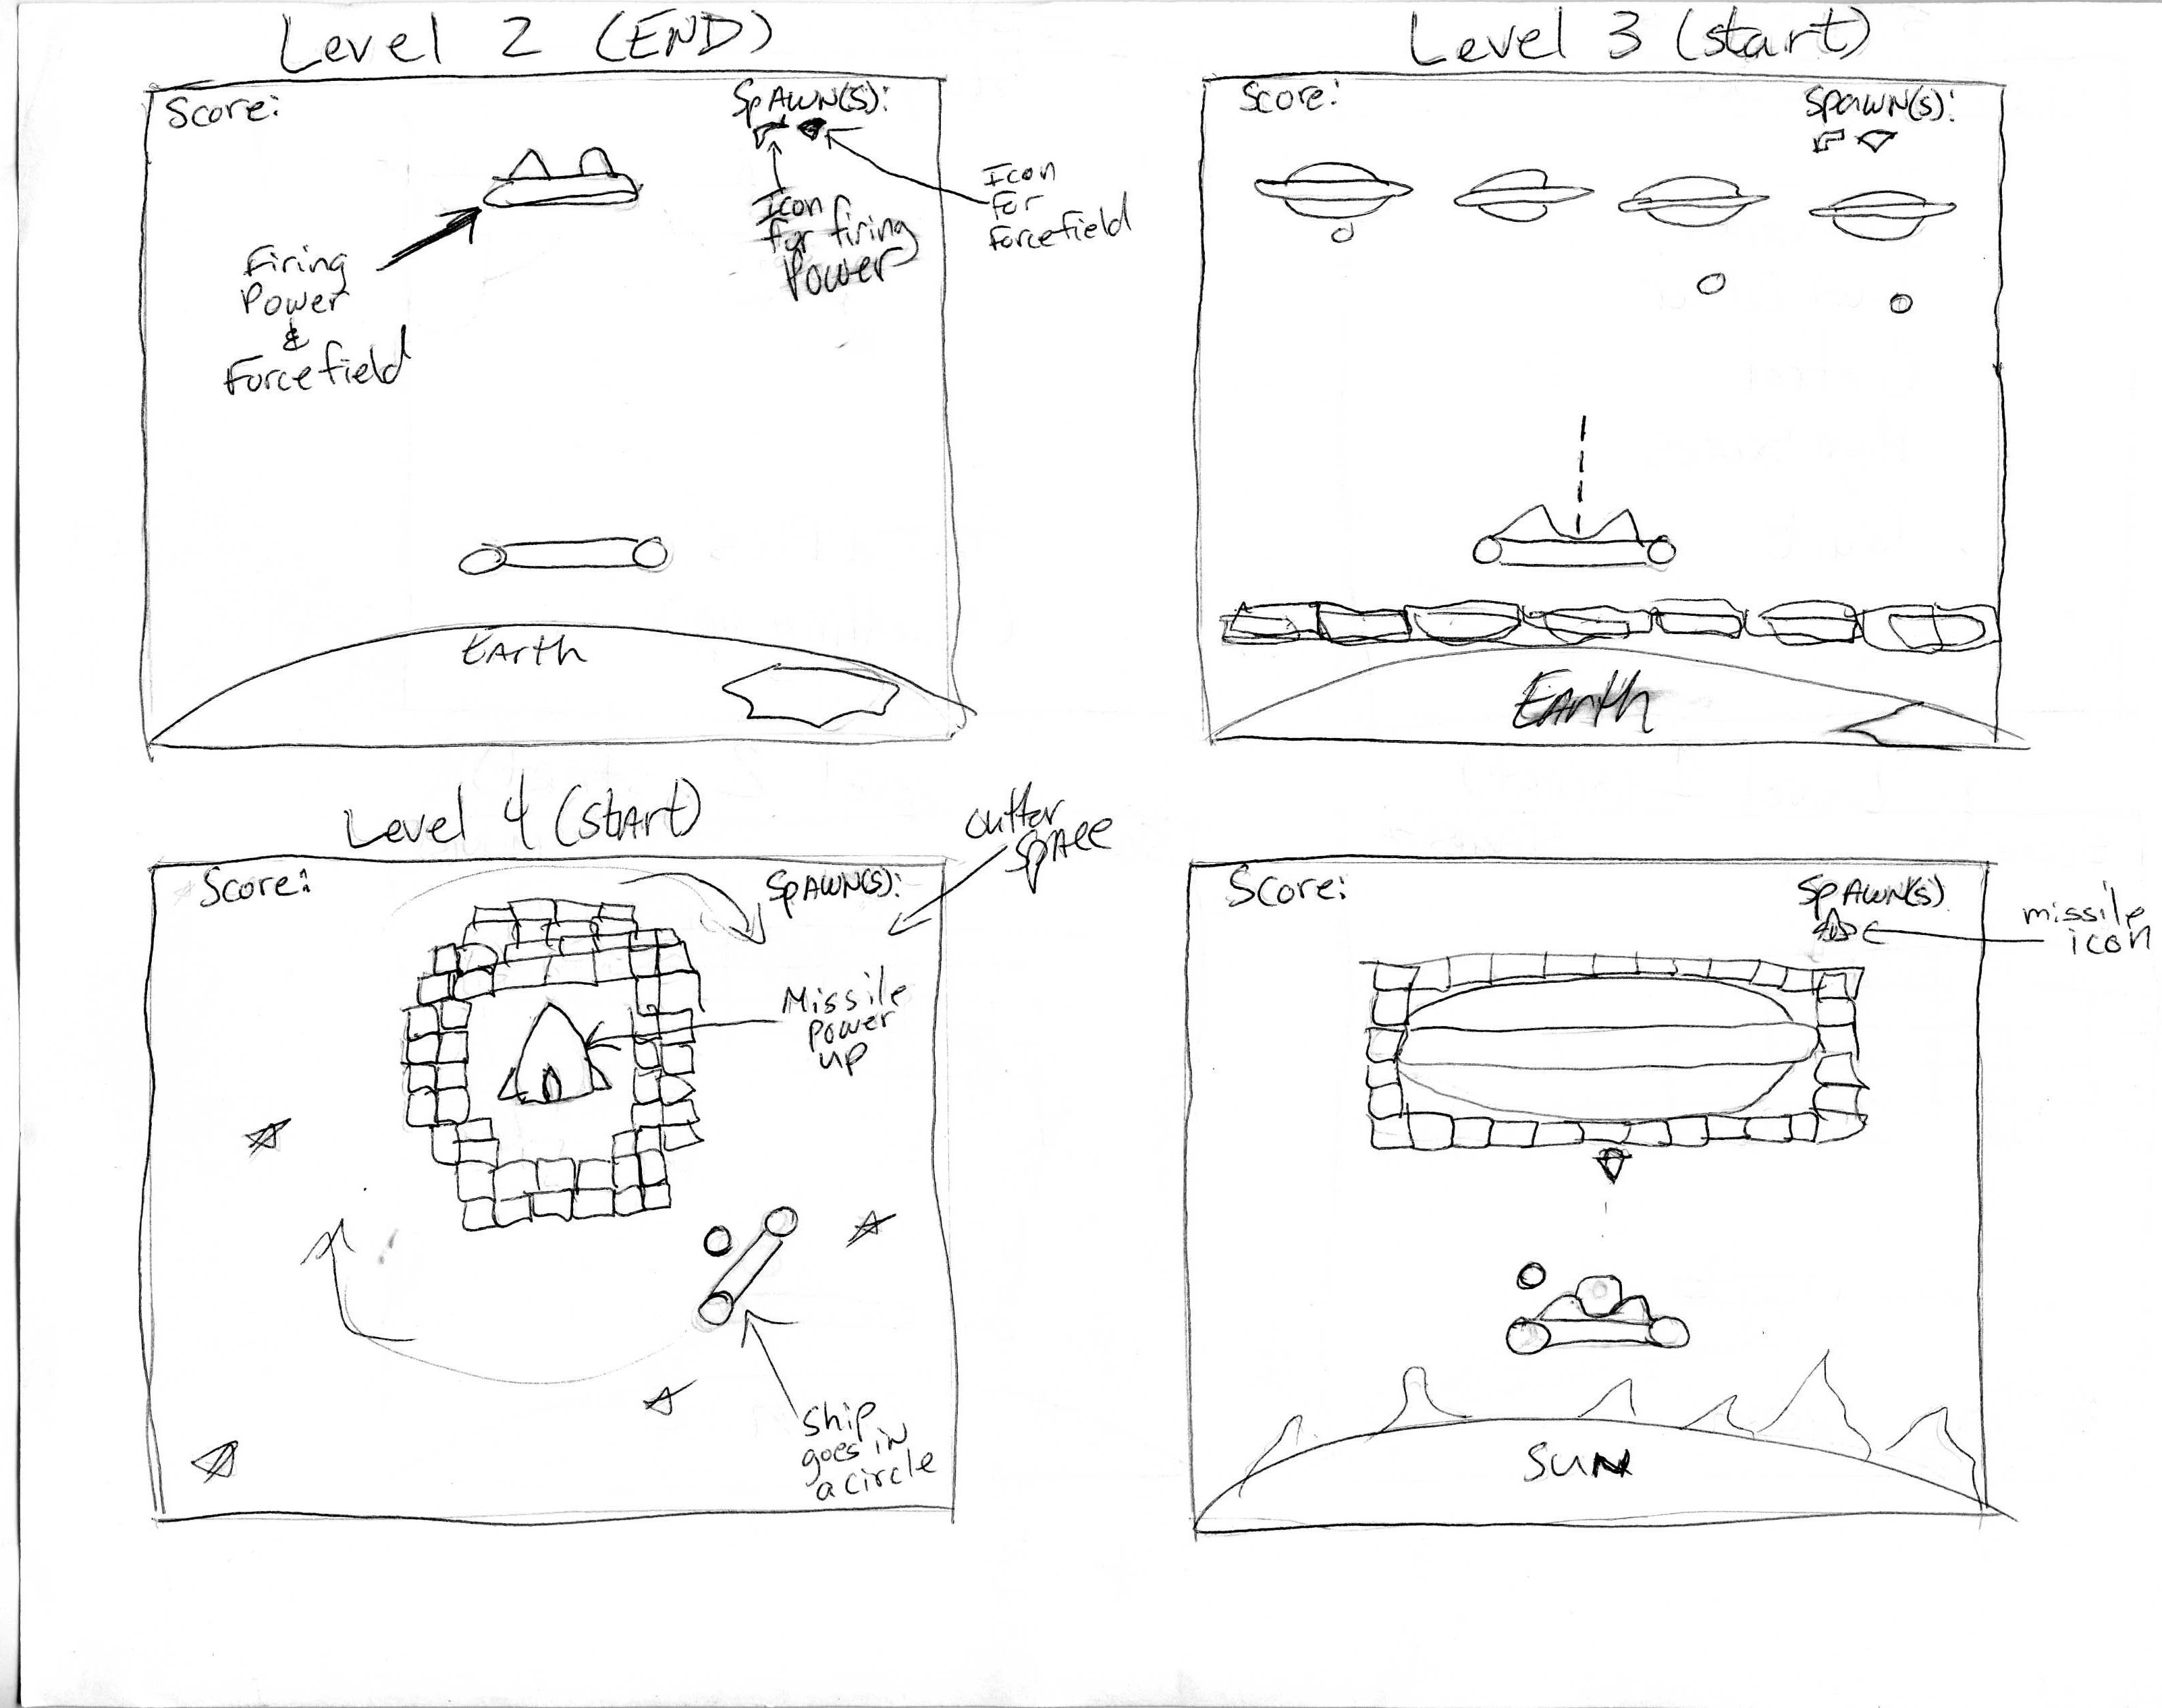
Story Board (2)

Slide 5
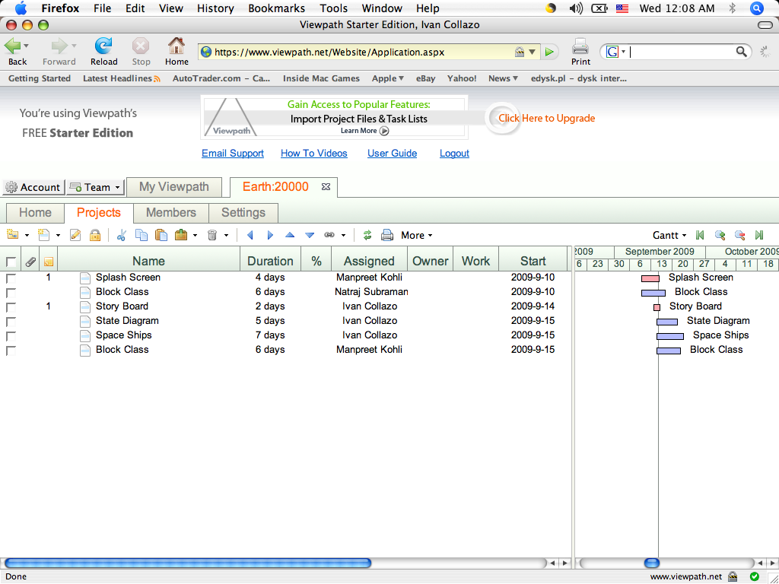
Gantt Chart

Slide 6
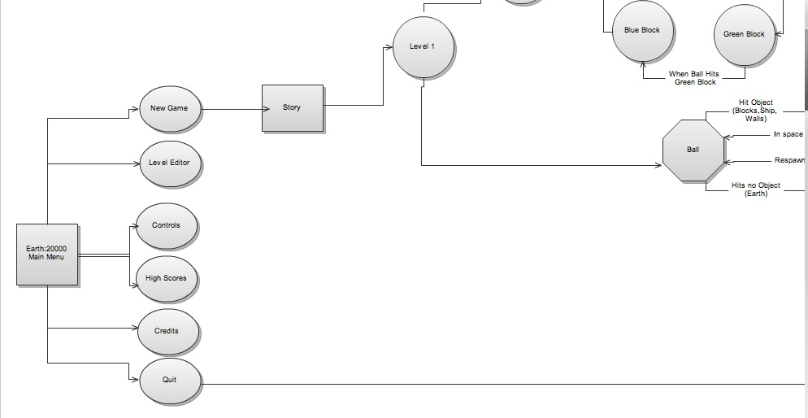
State Diagrams (1)

Slide 7
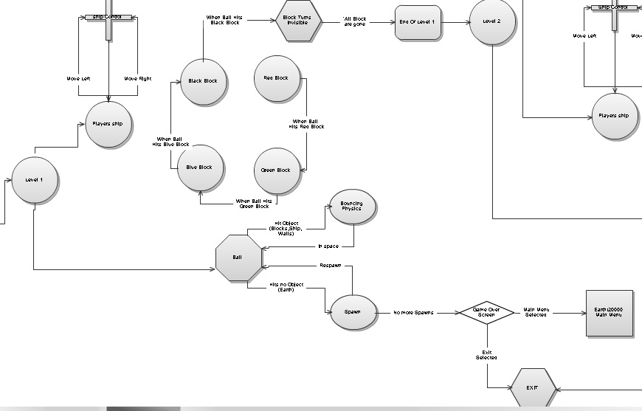
State Diagrams (2)

Slide 8
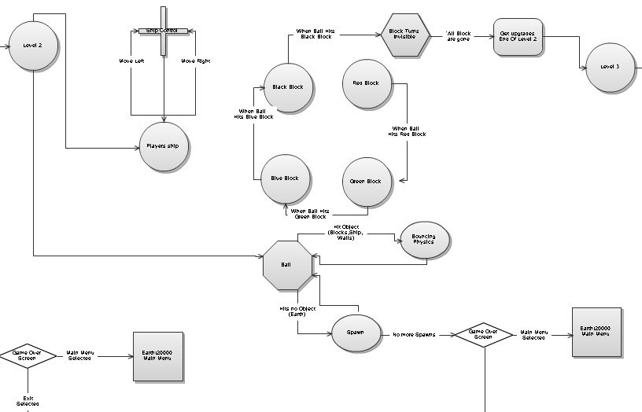
State Diagrams(3)

Slide 9
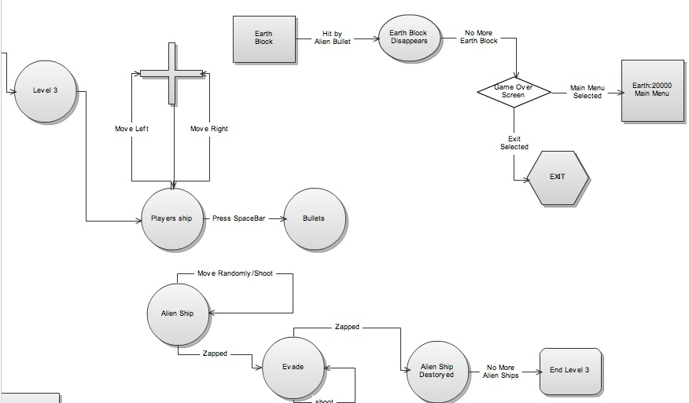
State Diagrams(4)

Slide 10
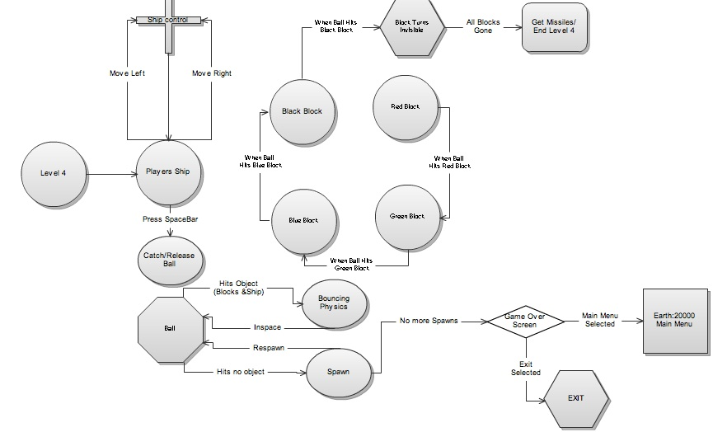
State Diagrams(5)

Slide 11
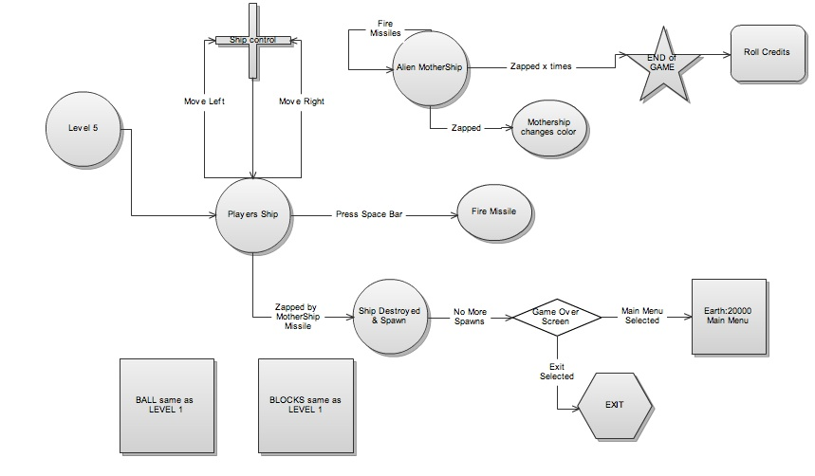
State Diagrams(6)

Slide 12
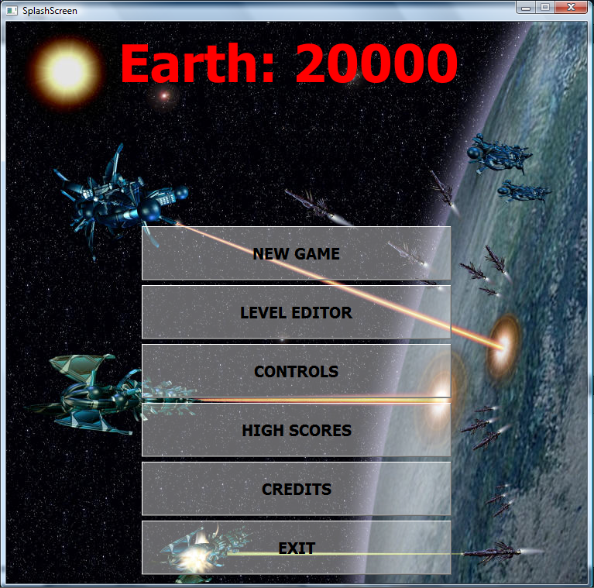
Splash Screen

